Slide 1


CISC450 Computer Networks
Lesson 7
Frame and Cell Relay
Slides courtesy of
William Stallings, Cisco
Systems and myself

Slide 2
Protocol Architecture
Similarities between ATM and packet switching
  Transfer of data in discrete chunks
  Multiple logical connections over single physical interface
In ATM flow on each logical connection is in fixed sized packets called cells
Minimal error and flow control
  Reduced overhead
Data rates (physical layer) 25.6Mbps to 622.08Mbps

Slide 3
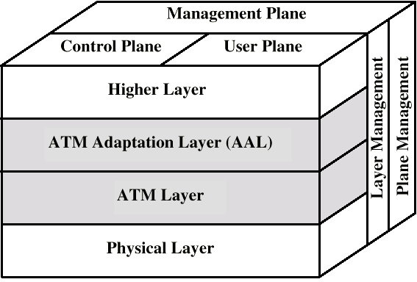
Protocol Architecture

Slide 4
Reference Model Planes
User plane
  Provides for user information transfer
Control plane
  Call and connection control
Management plane
  Plane management
    whole system functions
  Layer management
    Resources and parameters in protocol entities

Slide 5
ATM Logical Connections
Virtual channel connections (VCC)
Analogous to virtual circuit in X.25
Basic unit of switching
Between two end users
Full duplex
Fixed size cells
Data, user-network exchange (control) and network-network exchange (network management and routing)
Virtual path connection (VPC)
  Bundle of VCC with same end points

Slide 6
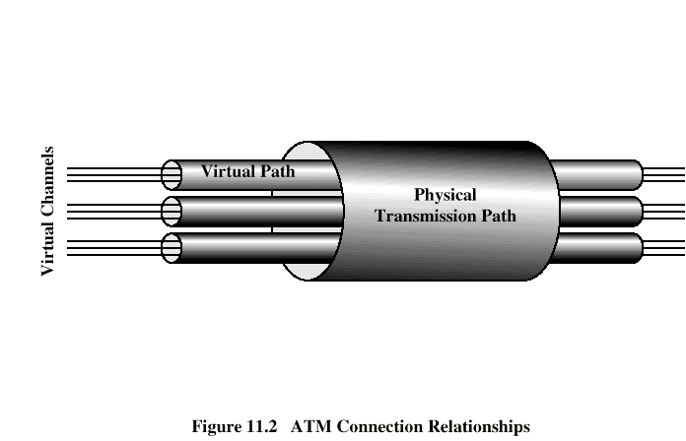
ATM Connection Relationships

Slide 7
Advantages of Virtual Paths
Simplified network architecture
Increased network performance and reliability
Reduced processing
Short connection setup time
Enhanced network services

Slide 8
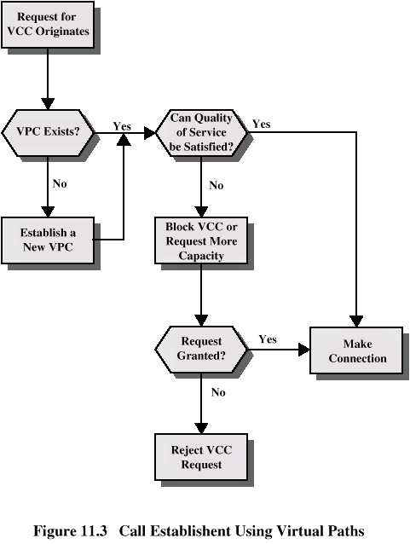
Call
Establishment
Using VPs

Slide 9
Virtual Channel Connection Uses
Between end users
  End to end user data
  Control signals
  VPC provides overall capacity
    VCC organization done by users
Between end user and network
  Control signaling
Between network entities
  Network traffic management
  Routing

Slide 10
VP/VC Characteristics
Quality of service
Switched and semi-permanent channel connections
Call sequence integrity
Traffic parameter negotiation and usage monitoring
VPC only
  Virtual channel identifier restriction within VPC

Slide 11
Control Signaling - VCC
Done on separate connection
Semi-permanent VCC
Meta-signaling channel
  Used as permanent control signal channel
User to network signaling virtual channel
  For control signaling
  Used to set up VCCs to carry user data
User to user signaling virtual channel
  Within pre-established VPC
  Used by two end users without network intervention to establish and release user to user VCC

Slide 12
Control Signaling - VPC
Semi-permanent
Customer controlled
Network controlled

Slide 13
ATM Cells
Fixed size
5 octet header
48 octet information field
Small cells reduce queuing delay for high priority cells
Small cells can be switched more efficiently
Easier to implement switching of small cells in hardware

Slide 14
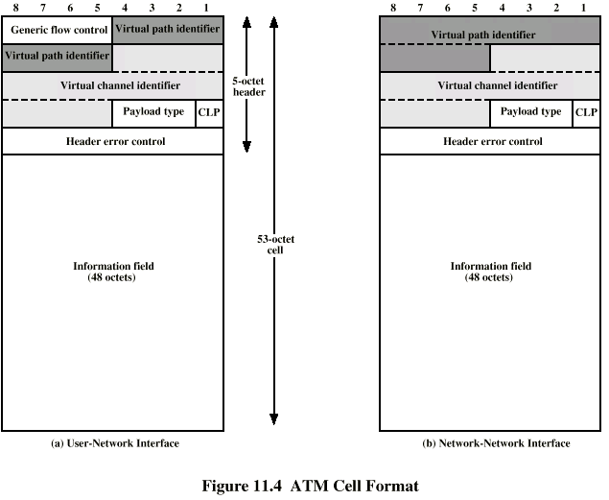
ATM Cell Format
What is different
between UNI and NNI
AND WHY?

Slide 15
Header Format
Generic flow control
  Only at user to network interface
  Controls flow only at this point
Virtual path identifier
Virtual channel identifier
Payload type
  e.g. user info or network management
Cell loss priority
Header error control

Slide 16
Generic Flow Control (GFC)
Control traffic flow at user to network interface (UNI) to alleviate short term overload
Two sets of procedures
  Uncontrolled transmission
  Controlled transmission
Every connection either subject to flow control or not
Subject to flow control
  May be one group (A) default
  May be two groups (A and B)
Flow control is from subscriber to network
  Controlled by network side

Slide 17
Single Group of Connections (1)
Terminal equipment (TE) initializes two variables
  TRANSMIT flag to 1
  GO_CNTR (credit counter) to 0
If TRANSMIT=1 cells on uncontrolled connection may be sent any time
If TRANSMIT=0 no cells may be sent (on controlled or uncontrolled connections)
If HALT received, TRANSMIT set to 0 and remains until NO_HALT

Slide 18
Single Group of Connections (2)
If TRANSMIT=1 and no cell to transmit on any uncontrolled connection:
  If GO_CNTR>0, TE may send cell on controlled connection
    Cell marked as being on controlled connection
    GO_CNTR decremented
  If GO_CNTR=0, TE may not send on controlled connection
TE sets GO_CNTR to GO_VALUE upon receiving SET signal
  Null signal has no effect

Slide 19
Use of HALT
To limit effective data rate on ATM
Should be cyclic
To reduce data rate by half, HALT issued to be in effect 50% of time
Done on regular pattern over lifetime of connection

Slide 20
Two Queue Model
Two counters
  GO_CNTR_A, GO_VALUE_A,GO_CNTR_B, GO_VALUE_B

Slide 21
Header Error Control
8 bit error control field
Calculated on remaining 32 bits of header
Allows some error correction

Slide 22
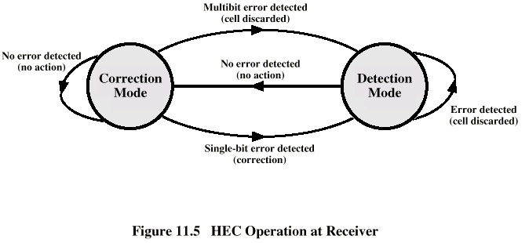
HEC Operation at Receiver

Slide 23
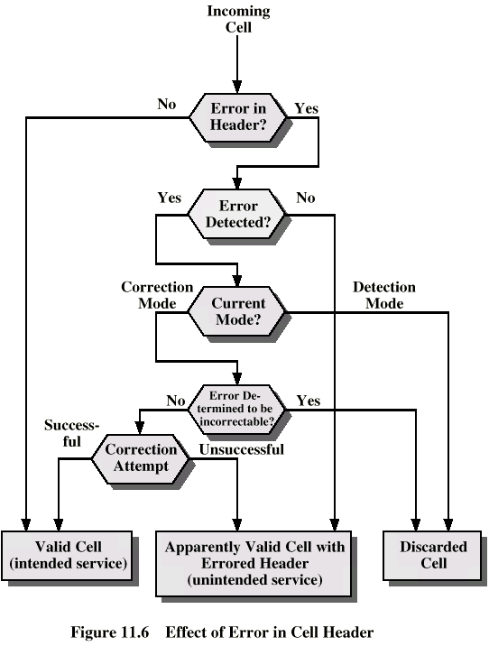
Effect of
Error in
Cell Header

Slide 24
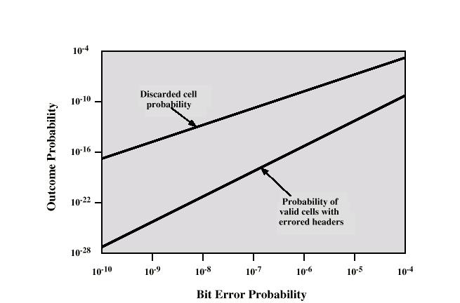
Impact of Random Bit Errors

Slide 25
Transmission of ATM Cells
622.08Mbps (OC-12)
155.52Mbps (OC-3)
51.84Mbps (OC-1)
25.6Mbps (OC-½? ☺)
Cell Based physical layer
SDH based physical layer

Slide 26
Cell Based Physical Layer
No framing imposed
Continuous stream of 53 octet cells
Cell delineation based on header error control field

Slide 27
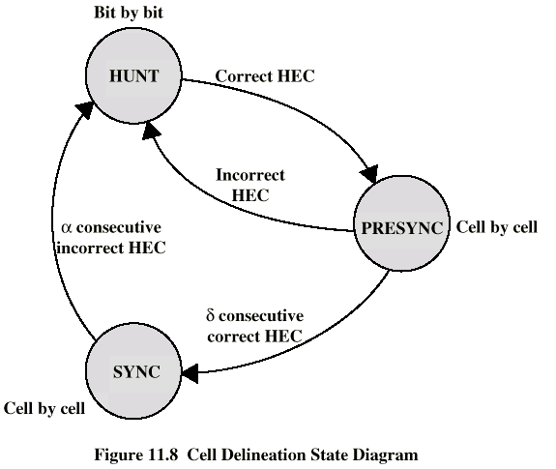
Cell Delineation State Diagram

Slide 28
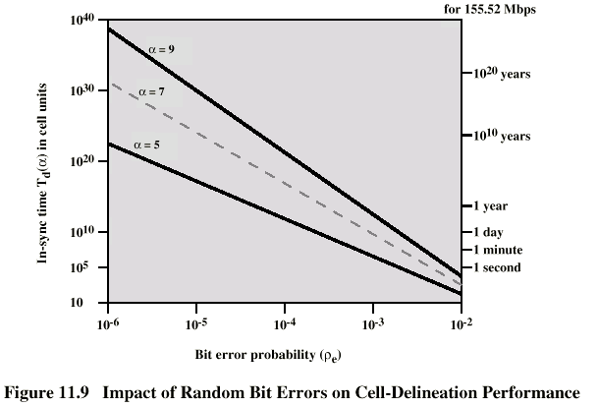
Impact of Random Bit Errors on Cell Delineation Performance

Slide 29
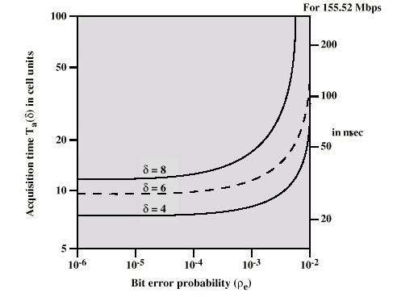
Acquisition Time v Bit Error Rate

Slide 30
SDH Based Physical Layer
Imposes structure on ATM stream
e.g. for 155.52Mbps
Use STM-1 (STS-3) frame
Can carry ATM and STM payloads
Specific connections can be circuit switched using SDH channel
SDH multiplexing techniques can combine several ATM streams

Slide 31
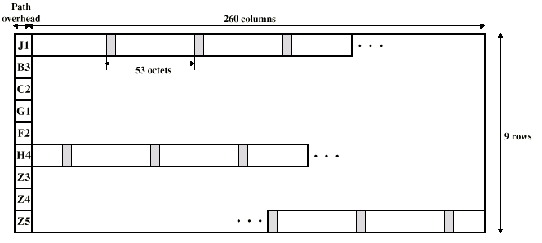
STM-1 Payload for SDH-Based ATM Cell Transmission

Slide 32
ATM Service Categories
Real time
  Constant bit rate (CBR)
  Real time variable bit rate (rt-VBR)
Non-real time
  Non-real time variable bit rate (nrt-VBR)
  Available bit rate (ABR)
  Unspecified bit rate (UBR)

Slide 33
Real Time Services
Amount of delay
Variation of delay (jitter)

Slide 34
CBR
Fixed data rate continuously available
Tight upper bound on delay
Uncompressed audio and video
  Video conferencing
  Interactive audio
  A/V distribution and retrieval

Slide 35
rt-VBR
Time sensitive application
  Tightly constrained delay and delay variation
rt-VBR applications transmit at a rate that varies with time
e.g. compressed video
  Produces varying sized image frames
  Original (uncompressed) frame rate constant
  So compressed data rate varies
Can statistically multiplex connections

Slide 36
nrt-VBR
May be able to characterize expected traffic flow
Improve QoS in loss and delay
End system specifies:
  Peak cell rate
  Sustainable or average rate
  Measure of how bursty traffic is
e.g. Airline reservations, banking transactions

Slide 37
UBR
May be additional capacity over and above that used by CBR and VBR traffic
  Not all resources dedicated
  Bursty nature of VBR
For application that can tolerate some cell loss or variable delays
  e.g. TCP based traffic
Cells forwarded on FIFO basis
Best efforts service

Slide 38
ABR
Application specifies peak cell rate (PCR) and minimum cell rate (MCR)
Resources allocated to give at least MCR
Spare capacity shared among all ARB sources
e.g. LAN interconnection

Slide 39
ATM Adaptation Layer
Support for information transfer protocol not based on ATM
PCM (voice)
  Assemble bits into cells
  Re-assemble into constant flow
IP
  Map IP packets onto ATM cells
  Fragment IP packets
  Use LAPF over ATM to retain all IP infrastructure

Slide 40
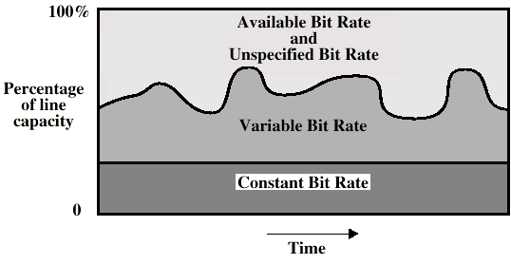
ATM Bit Rate Services

Slide 41
Adaptation Layer Services
Handle transmission errors
Segmentation and re-assembly
Handle lost and misinserted cells
Flow control and timing

Slide 42
Supported Application types
Circuit emulation
VBR voice and video
General data service
IP over ATM
Multiprotocol encapsulation over ATM (MPOA)
  IPX, AppleTalk, DECNET)
LAN emulation

Slide 43
AAL Protocols
Convergence sublayer (CS)
  Support for specific applications
  AAL user attaches at SAP
Segmentation and re-assembly sublayer (SAR)
  Packages and unpacks info received from CS into cells
Four types
  Type 1
  Type 2
  Type 3/4
  Type 5

Slide 44
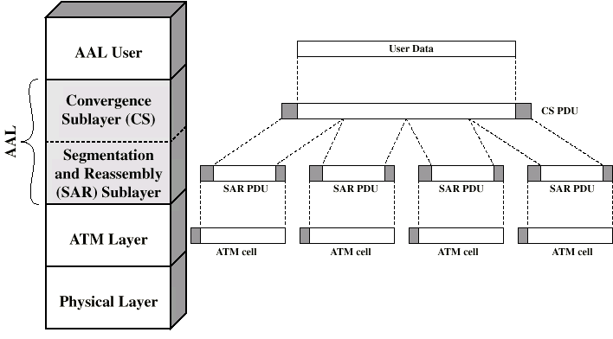
AAL Protocols

Slide 45
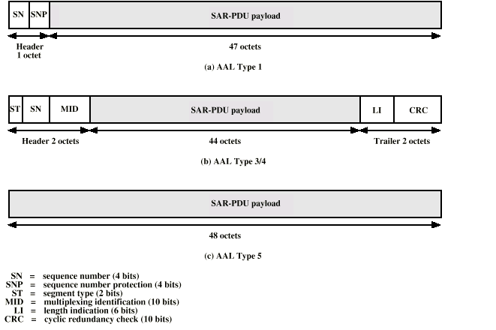
Segmentation and Reassembly PDU

Slide 46
AAL Type 1
CBR source
SAR packs and unpacks bits
Block accompanied by sequence number

Slide 47
AAL Type 2
VBR
Analog applications

Slide 48
AAL Type 3/4
Connectionless or connected
Message mode or stream mode

Slide 49
AAL Type 5
Streamlined transport for connection oriented higher layer protocols

Slide 50
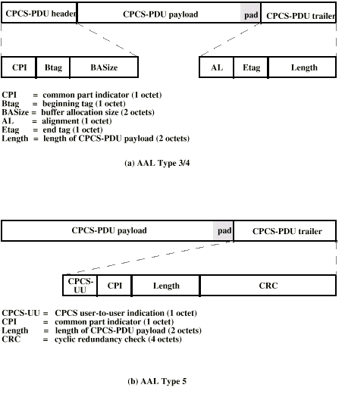
CPCS PDUs

Slide 51
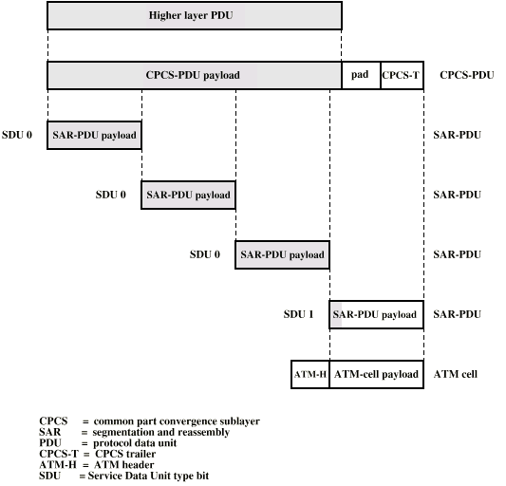
Example AAL 5 Transmission

Slide 52
Frame Relay
Designed to be more efficient than X.25
Developed before ATM
Larger installed base than ATM
ATM now of more interest on high speed networks

Slide 53
Frame Relay Background - X.25
Call control packets, in band signaling
Multiplexing of virtual circuits at layer 3
Layer 2 and 3 include flow and error control
Considerable overhead
Not appropriate for modern digital systems with high reliability

Slide 54
Frame Relay - Differences
Call control carried in separate logical connection
Multiplexing and switching at layer 2
  Eliminates one layer of processing
No hop by hop error or flow control
End to end flow and error control (if used) are done by higher layer
Single user data frame sent from source to destination and ACK (from higher layer) sent back

Slide 55
Advantages and Disadvantages
Lost link by link error and flow control
  Increased reliability makes this less of a problem
Streamlined communications process
  Lower delay
  Higher throughput
ITU-T recommend frame relay above 2Mbps

Slide 56
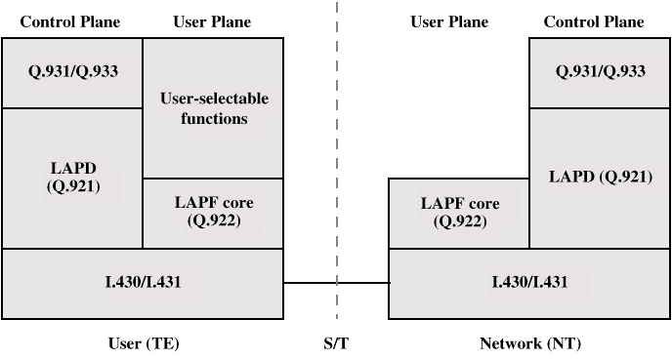
Protocol Architecture

Slide 57
Control Plane
Between subscriber and network
Separate logical channel used
  Similar to common channel signaling for circuit switching services
Data link layer
  LAPD (Q.921)
  Reliable data link control
  Error and flow control
  Between user (TE) and network (NT)
  Used for exchange of Q.933 control signal messages

Slide 58
User Plane
End to end functionality
Transfer of info between ends
LAPF (Link Access Procedure for Frame Mode Bearer Services) Q.922
  Frame delimiting, alignment and transparency
  Frame mux and demux using addressing field
  Ensure frame is integral number of octets (zero bit insertion/extraction)
  Ensure frame is neither too long nor short
  Detection of transmission errors
  Congestion control functions

Slide 59
User Data Transfer
One frame type
  User data
  No control frame
No inband signaling
No sequence numbers
  No flow nor error control

Slide 60
What Is Congestion?
Congestion occurs when the number of packets being transmitted through the network approaches the packet handling capacity of the network
Congestion control aims to keep number of packets below level at which performance falls off dramatically
Data network is a network of queues
Generally 80% utilization is critical
Finite queues mean data may be lost

Slide 61
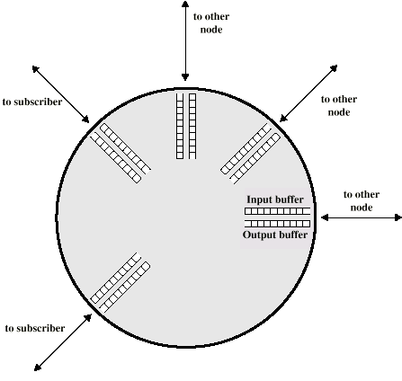
Queues at a Node

Slide 62
Effects of Congestion
Packets arriving are stored at input buffers
Routing decision made
Packet moves to output buffer
Packets queued for output transmitted as fast as possible
  Statistical time division multiplexing
If packets arrive to fast to be routed, or to be output, buffers will fill
Can discard packets
Can use flow control
  Can propagate congestion through network

Slide 63
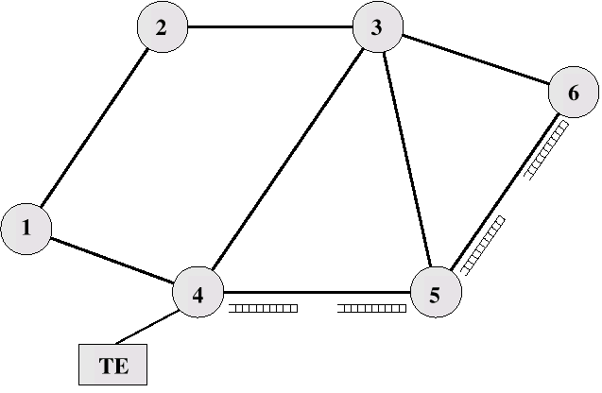
Interaction of Queues

Slide 64
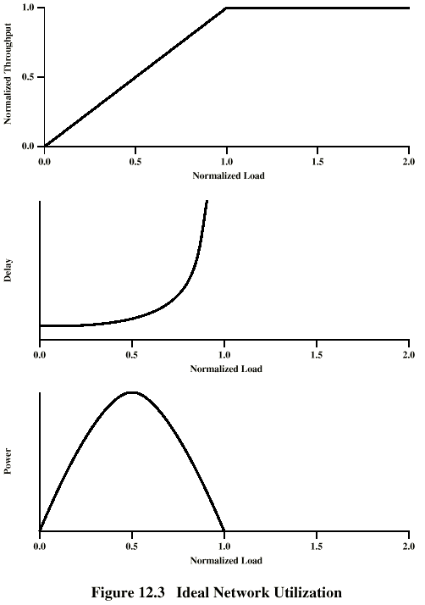
Ideal
Performance

Slide 65
Practical Performance
Ideal assumes infinite buffers and no overhead
Buffers are finite
Overheads occur in exchanging congestion control messages

Slide 66
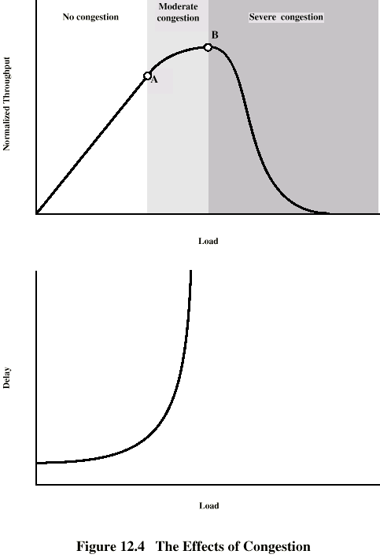
Effects of
Congestion -
No Control

Slide 67
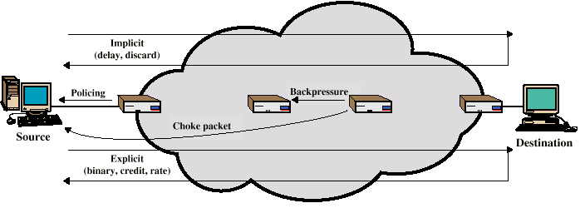
Mechanisms for
Congestion Control

Slide 68
Backpressure
If node becomes congested it can slow down or halt flow of packets from other nodes
May mean that other nodes have to apply control on incoming packet rates
Propagates back to source
Can restrict to logical connections generating most traffic
Used in connection oriented that allow hop by hop congestion control (e.g. X.25)
Not used in ATM nor frame relay
Only recently developed for IP

Slide 69
Choke Packet
FR equivalent to
XON-XOFF Flow Control
(don’t confuse with
“wax on-wax off ☺)
Control packet
  Generated at congested node
  Sent to source node
  e.g. ICMP source quench
    From router or destination
    Source cuts back until no more source quench message
    Sent for every discarded packet, or anticipated
Rather crude mechanism

Slide 70
Implicit Congestion Signaling
Transmission delay may increase with congestion
Packet may be discarded
Source can detect these as implicit indications of congestion
Useful on connectionless (datagram) networks
  e.g. IP based
    (TCP includes congestion and flow control - see chapter 17)
Used in frame relay LAPF

Slide 71
Explicit Congestion Signaling
Network alerts end systems of increasing congestion
End systems take steps to reduce offered load
Backwards
  Congestion avoidance in opposite direction to packet required
Forwards
  Congestion avoidance in same direction as packet required

Slide 72
Categories of Explicit Signaling
Binary
  A bit set in a packet indicates congestion
Credit based
  Indicates how many packets source may send
  Common for end to end flow control
Rate based
  Supply explicit data rate limit
  e.g. ATM

Slide 73
Traffic Management
Fairness
Quality of service
  May want different treatment for different connections
Reservations
  e.g. ATM
  Traffic contract between user and network

Slide 74
Congestion Control in Packet Switched Networks
Send control packet to some or all source nodes
  Requires additional traffic during congestion
Rely on routing information
  May react too quickly
End to end probe packets
  Adds to overhead
Add congestion info to packets as they cross nodes
  Either backwards or forwards

Slide 75
ATM Traffic Management
High speed, small cell size, limited overhead bits
Still evolving
Requirements
  Majority of traffic not amenable to flow control
  Feedback slow due to reduced transmission time compared with propagation delay
  Wide range of application demands
  Different traffic patterns
  Different network services
  High speed switching and transmission increases volatility

Slide 76
Latency/Speed Effects
ATM 150Mbps
~2.8x10⁻⁶ seconds to insert single cell
Time to traverse network depends on propagation delay, switching delay
Assume propagation at two-thirds speed of light
If source and destination on opposite sides of USA, propagation time ~ 48x10⁻³ seconds
Given implicit congestion control, by the time dropped cell notification has reached source, 7.2x10⁶ bits have been transmitted
So, this is not a good strategy for ATM

Slide 77
Cell Delay Variation
For ATM voice/video, data is a stream of cells
Delay across network must be short
Rate of delivery must be constant
There will always be some variation in transit
Delay cell delivery to application so that constant bit rate can be maintained to application

Slide 78
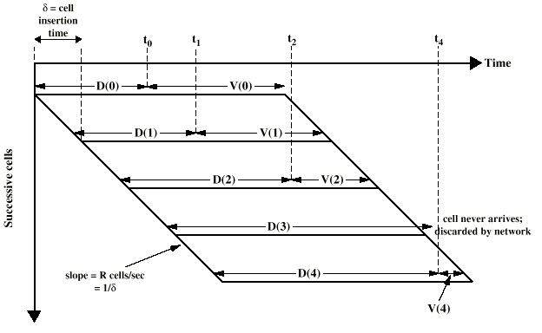
Time Re-assembly of CBR Cells

Slide 79
Network Contribution to
Cell Delay Variation
Packet switched networks
  Queuing delays
  Routing decision time
Frame relay
  As above but to lesser extent
ATM
  Less than frame relay
  ATM protocol designed to minimize processing overheads at switches
  ATM switches have very high throughput
  Only noticeable delay is from congestion
  Must not accept load that causes congestion

Slide 80
Cell Delay Variation
At The UNI
Application produces data at fixed rate
Processing at three layers of ATM causes delay
  Interleaving cells from different connections
  Operation and maintenance cell interleaving
  If using synchronous digital hierarchy frames, these are inserted at physical layer
  Can not predict these delays

Slide 81
Traffic and Congestion
Control Framework
ATM layer traffic and congestion control should support QoS classes for all foreseeable network services
Should not rely on AAL protocols that are network specific, nor higher level application specific protocols
Should minimize network and end to end system complexity

Slide 82
Timings Considered
Cell insertion time
Round trip propagation time
Connection duration
Long term
Determine whether a given new connection can be accommodated
Agree performance parameters with subscriber

Slide 83
Traffic Management and Congestion Control Techniques
Resource management using virtual paths
Connection admission control
Usage parameter control
Selective cell discard
Traffic shaping

Slide 84
Resource Management Using Virtual Paths
Separate traffic flow according to service characteristics
User to user application
User to network application
Network to network application
Concern with:
  Cell loss ratio
  Cell transfer delay
  Cell delay variation

Slide 85
Allocating VCCs within VPC
All VCCs within VPC should experience similar network performance
Options for allocation:
  Aggregate peak demand
  Statistical multiplexing

Slide 86
Connection Admission Control
First line of defense
User specifies traffic characteristics for new connection (VCC or VPC) by selecting a QoS
Network accepts connection only if it can meet the demand
Traffic contract
  Peak cell rate
  Cell delay variation
  Sustainable cell rate
  Burst tolerance

Slide 87
Usage Parameter Control
Monitor connection to ensure traffic cinforms to contract
Protection of network resources from overload by one connection
Done on VCC and VPC
Peak cell rate and cell delay variation
Sustainable cell rate and burst tolerance
Discard cells that do not conform to traffic contract
Called traffic policing

Slide 88
Traffic Shaping
Smooth out traffic flow and reduce cell clumping
Token bucket

Slide 89
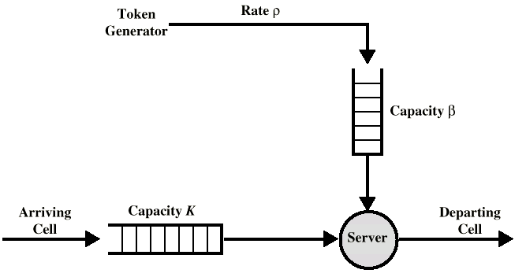
Token Bucket

Slide 90
ATM-ABR Traffic Management
Some applications (Web, file transfer) do not have well defined traffic characteristics
Best efforts
  Allow these applications to share unused capacity
    If congestion builds, cells are dropped
Closed loop control
  ABR connections share available capacity
  Share varies between minimum cell rate (MCR) and peak cell rate (PCR)
  ARB flow limited to available capacity by feedback
    Buffers absorb excess traffic during feedback delay
  Low cell loss

Slide 91
Feedback Mechanisms
Transmission rate characteristics:
  Allowed cell rate
  Minimum cell rate
  Peak cell rate
  Initial cell rate
Start with ACR=ICR
Adjust ACR based on feedback from network
  Resource management cells
    Congestion indication bit
    No increase bit
    Explicit cell rate field

Slide 92
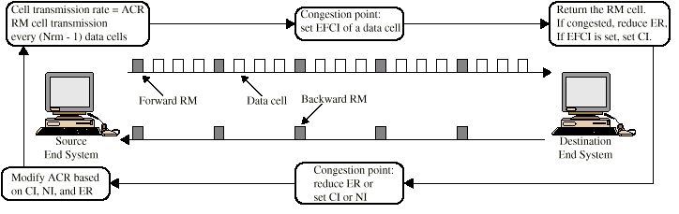
Cell Flow

Slide 93
Rate Control Feedback
EFCI (Explicit forward congestion indication) marking
Relative rate marking
Explicit rate marking

Slide 94
Frame Relay
Congestion Control
Minimize discards
Miantain agreed QoS
Minimize probability of one end user monoply
Simple to implement
  Little overhead on network or user
Create minimal additional traffic
Distribute resources fairly
Limit spread of congestion
Operate effectively regardless of traffic flow
Minimum impact on other systems
Minimize variance in QoS

Slide 95
Techniques
Discard strategy
Congestion avoidance
Explicit signaling
Congestion recovery
Implicit signaling mechanism

Slide 96
Traffic Rate Management
Must discard frames to cope with congestion
  Arbitrarily, no regard for source
  No reward for restraint so end systems transmit as fast as possible
  Committed information rate (CIR)
    Data in excess of this liable to discard
    Not guaranteed
    Aggregate CIR should not exceed physical data rate
Committed burst size
Excess burst size

Slide 97
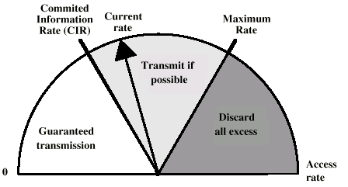
Operation of CIR

Slide 98
Explicit Signaling
Network alerts end systems of growing congestion
Backward explicit congestion notification
Forward explicit congestion notification
Frame handler monitors its queues
May notify some or all logical connections
User response
  Reduce rate

